Slide 1
P-266 Resume Classification
Mentor : Mr. Kartik Muskula
-:Presented by:-
Group No.: 02
Ms. Sana Sultana
Mr. Chinmay Milind Nikumbh
Mr. Amol Shalikram Dongare
Ms. Sweety Rajendra Nandurkar
Mr. PUGALENDHI S
Mr. Rajesh Kumar Sethi
Mr. Rohit Sanjay Gadekar

Slide 2
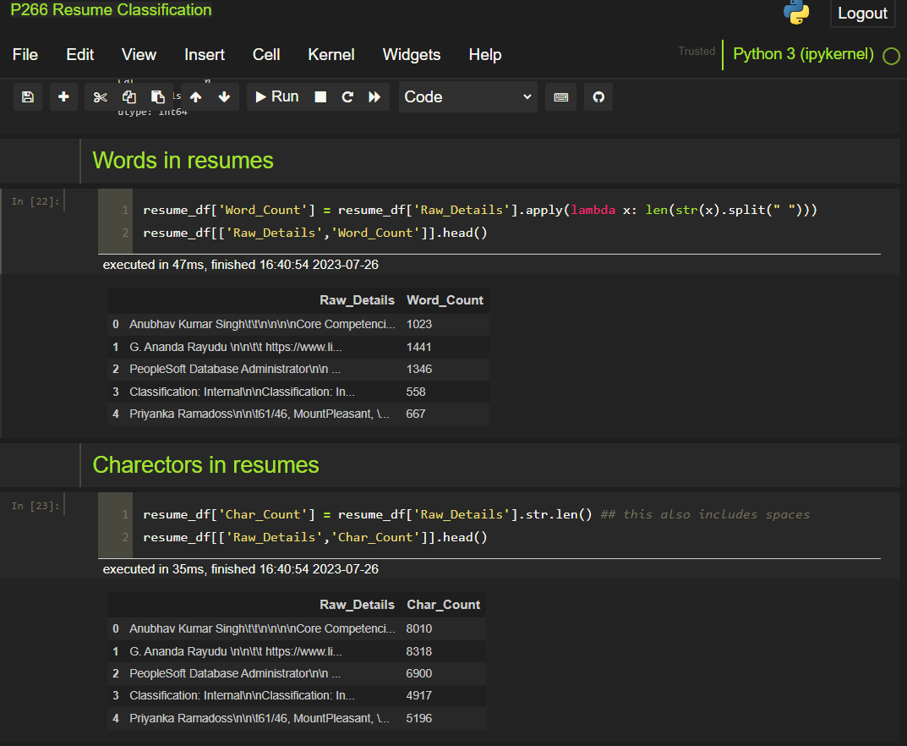
Words, Characters, Stop Words and Numeric in Resumes

Slide 3
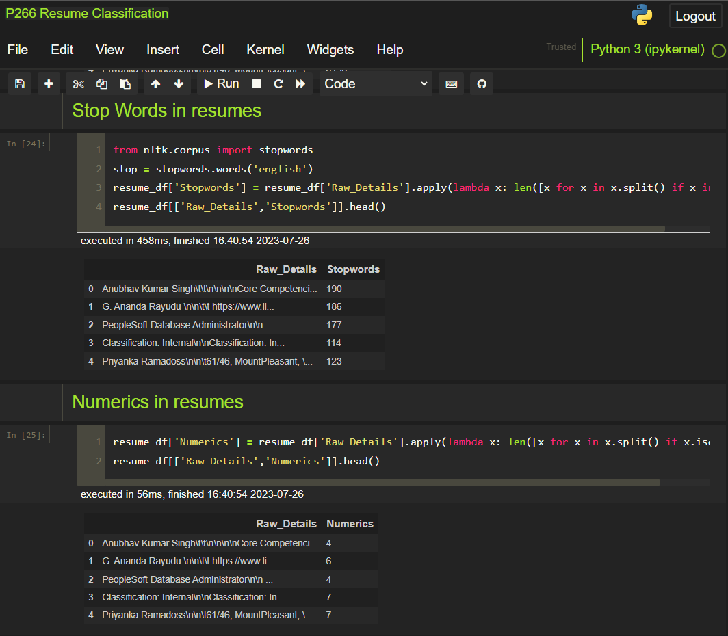
Words, Characters, Stop Words and Numeric in Resumes

Slide 4
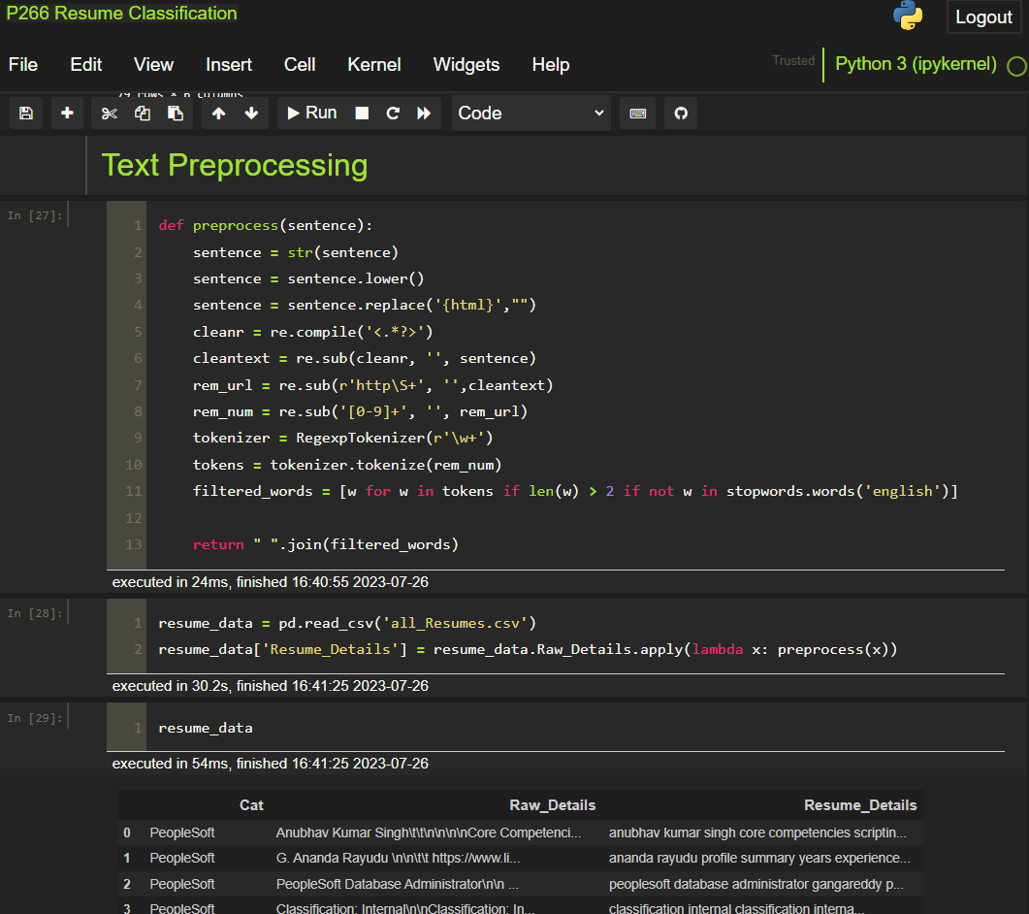
Text Preprocessing

Slide 5
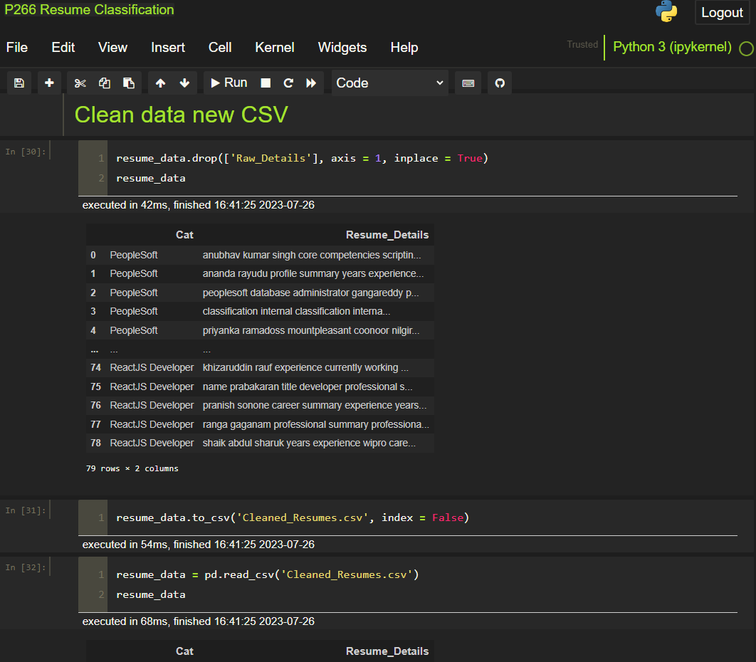
Clean Data New CSV

Slide 6
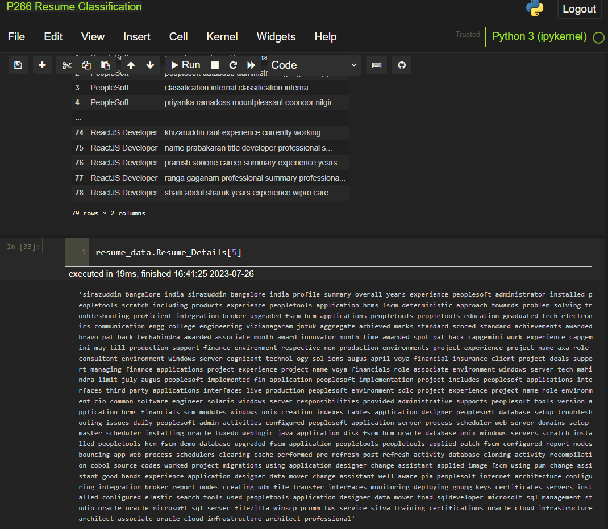
Clean Data New CSV

Slide 7
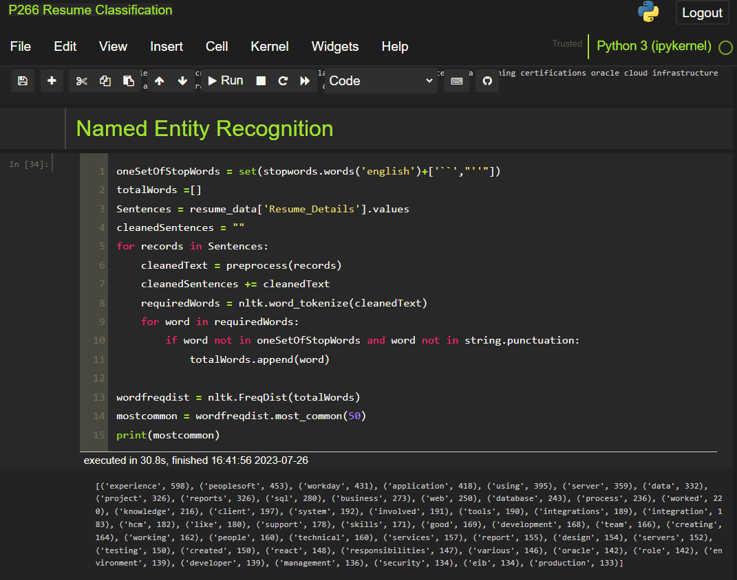
Named Entity Recognition (NRE)

Slide 8
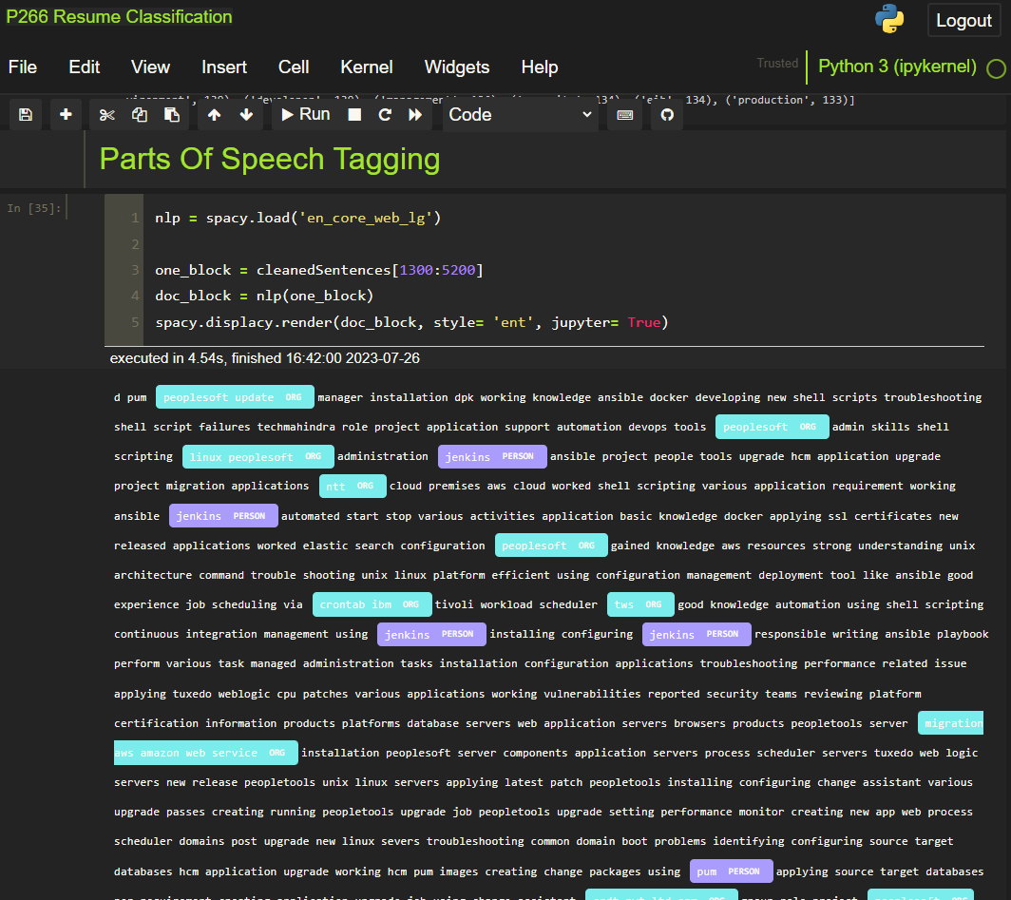
Part Of Speech Tagging (POS)

Slide 9
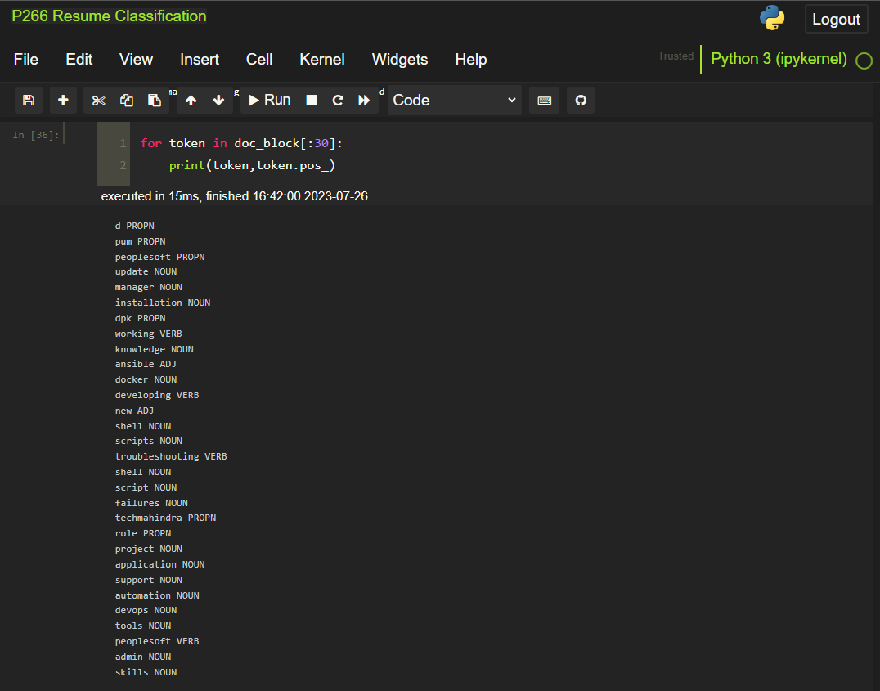
Part Of Speech Tagging (POS)

Slide 10
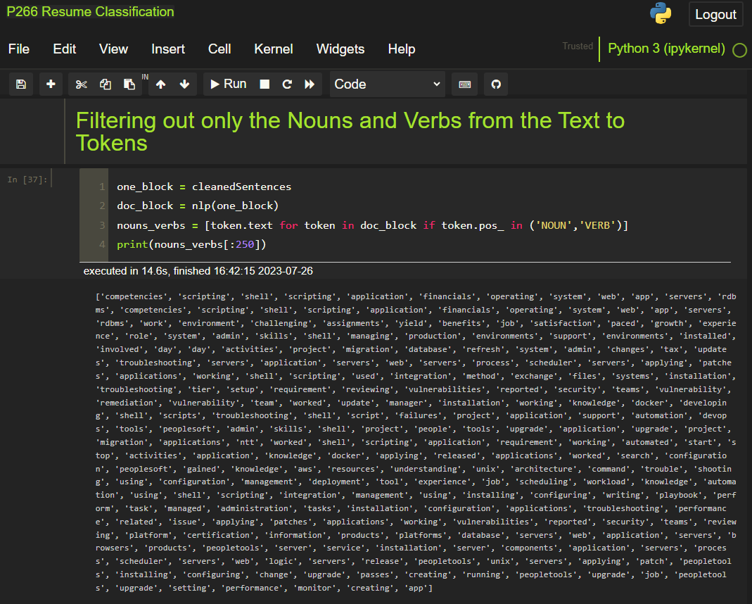
Filtering Out Only Verbs and Nouns From The Text To Tokens

Slide 11
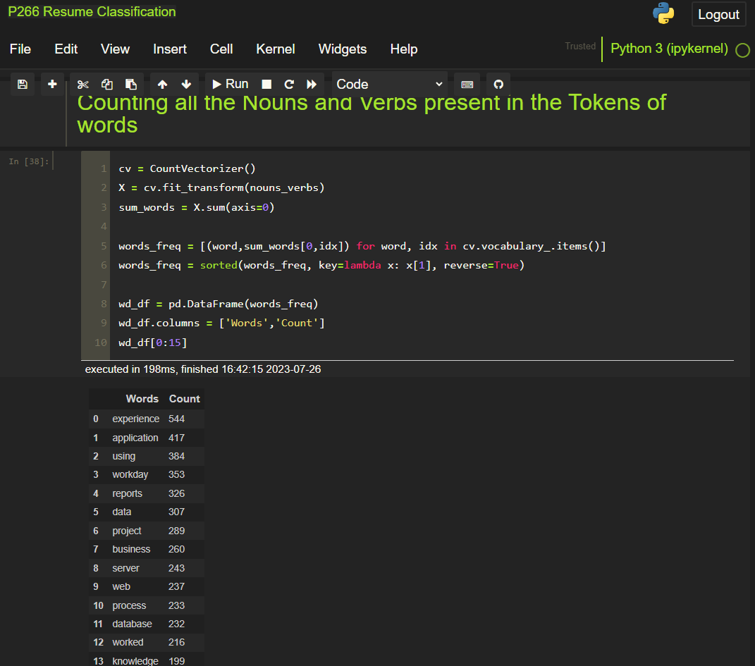
Counting All Verbs and Nouns Presented In The Text To Tokens

Slide 12
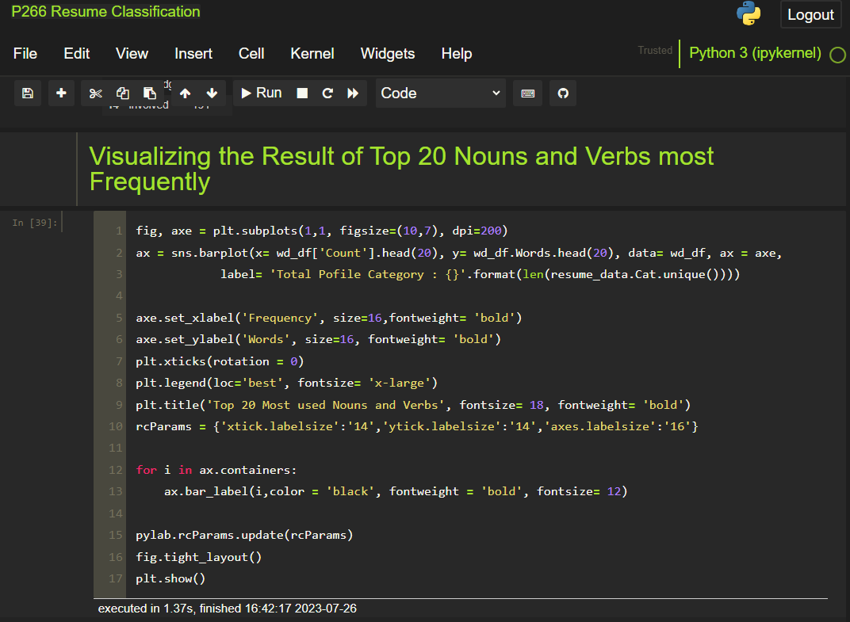
Visualizing The Most Frequently Use Top 20 Verbs And Nouns

Slide 13
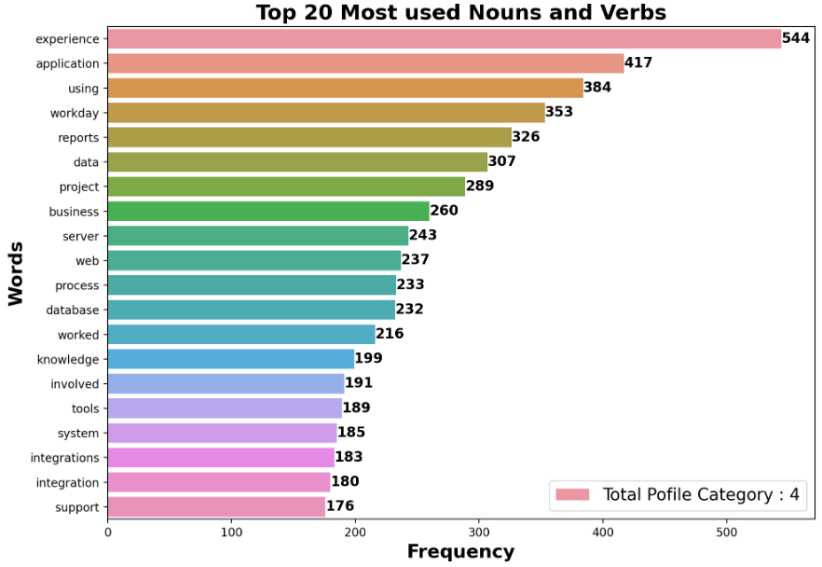
Visualizing The Most Frequently Use Top 20 Verbs And Nouns

Slide 14
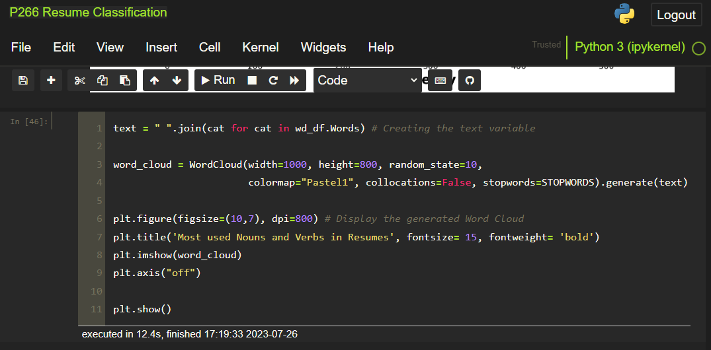
Word Cloud

Slide 15
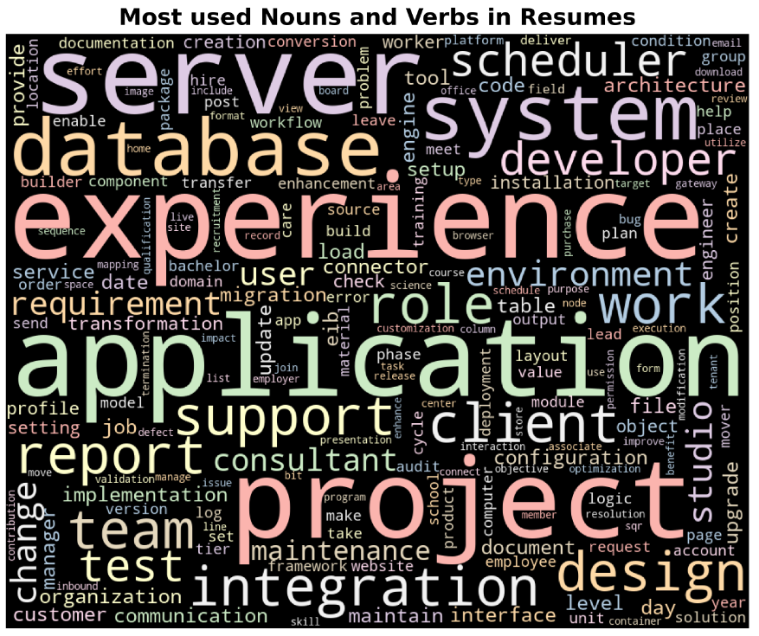
Word Cloud

Slide 16
Thank You.

